Slide 1



RRB 2023 . IBM Federal Garage
Form, function, placement
Design —
Change of Address .

Slide 2
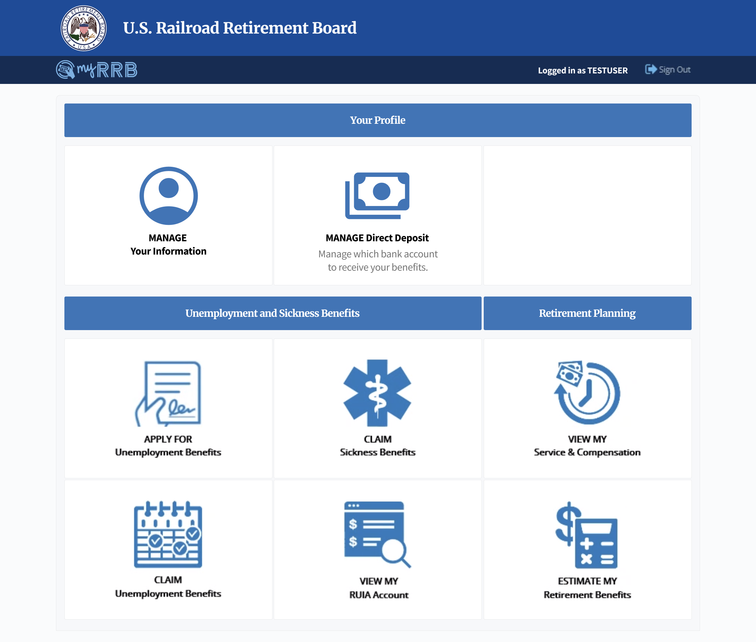
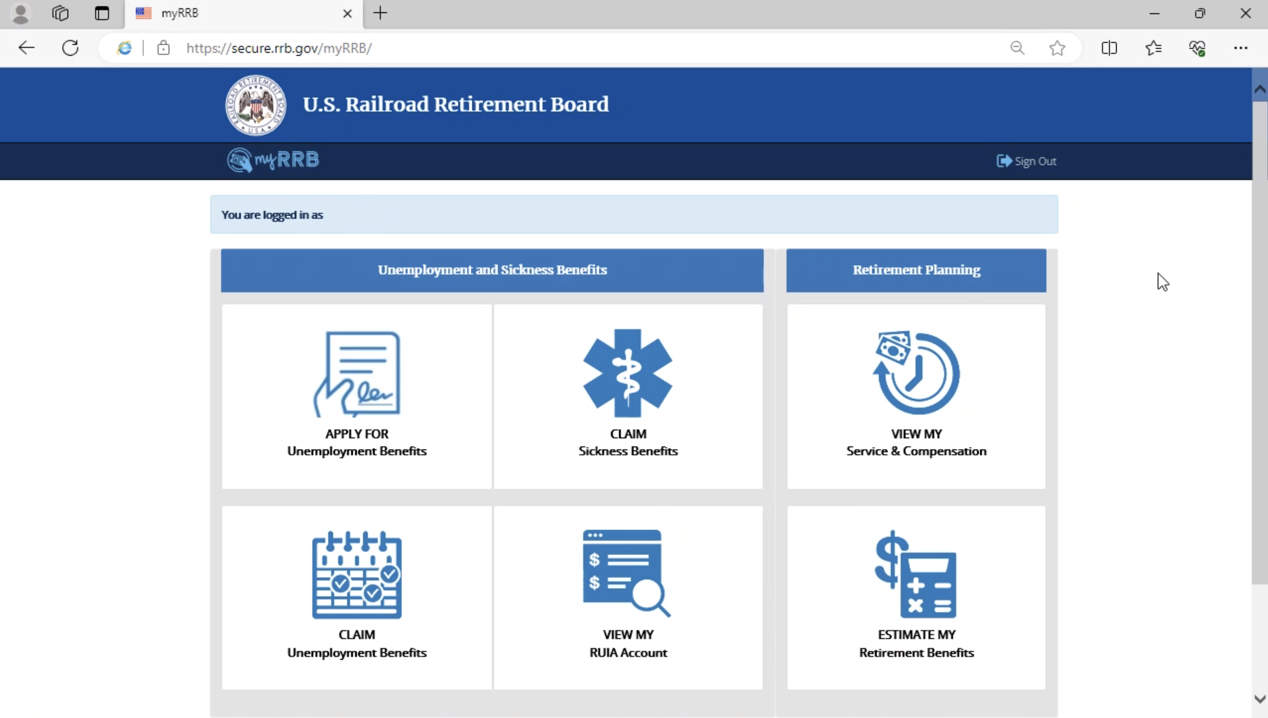
Change of Address
Profile
A new profile section lets users manage their profile information.
1
1
Manage personal information in one place.
Current dashboard
2

Slide 3
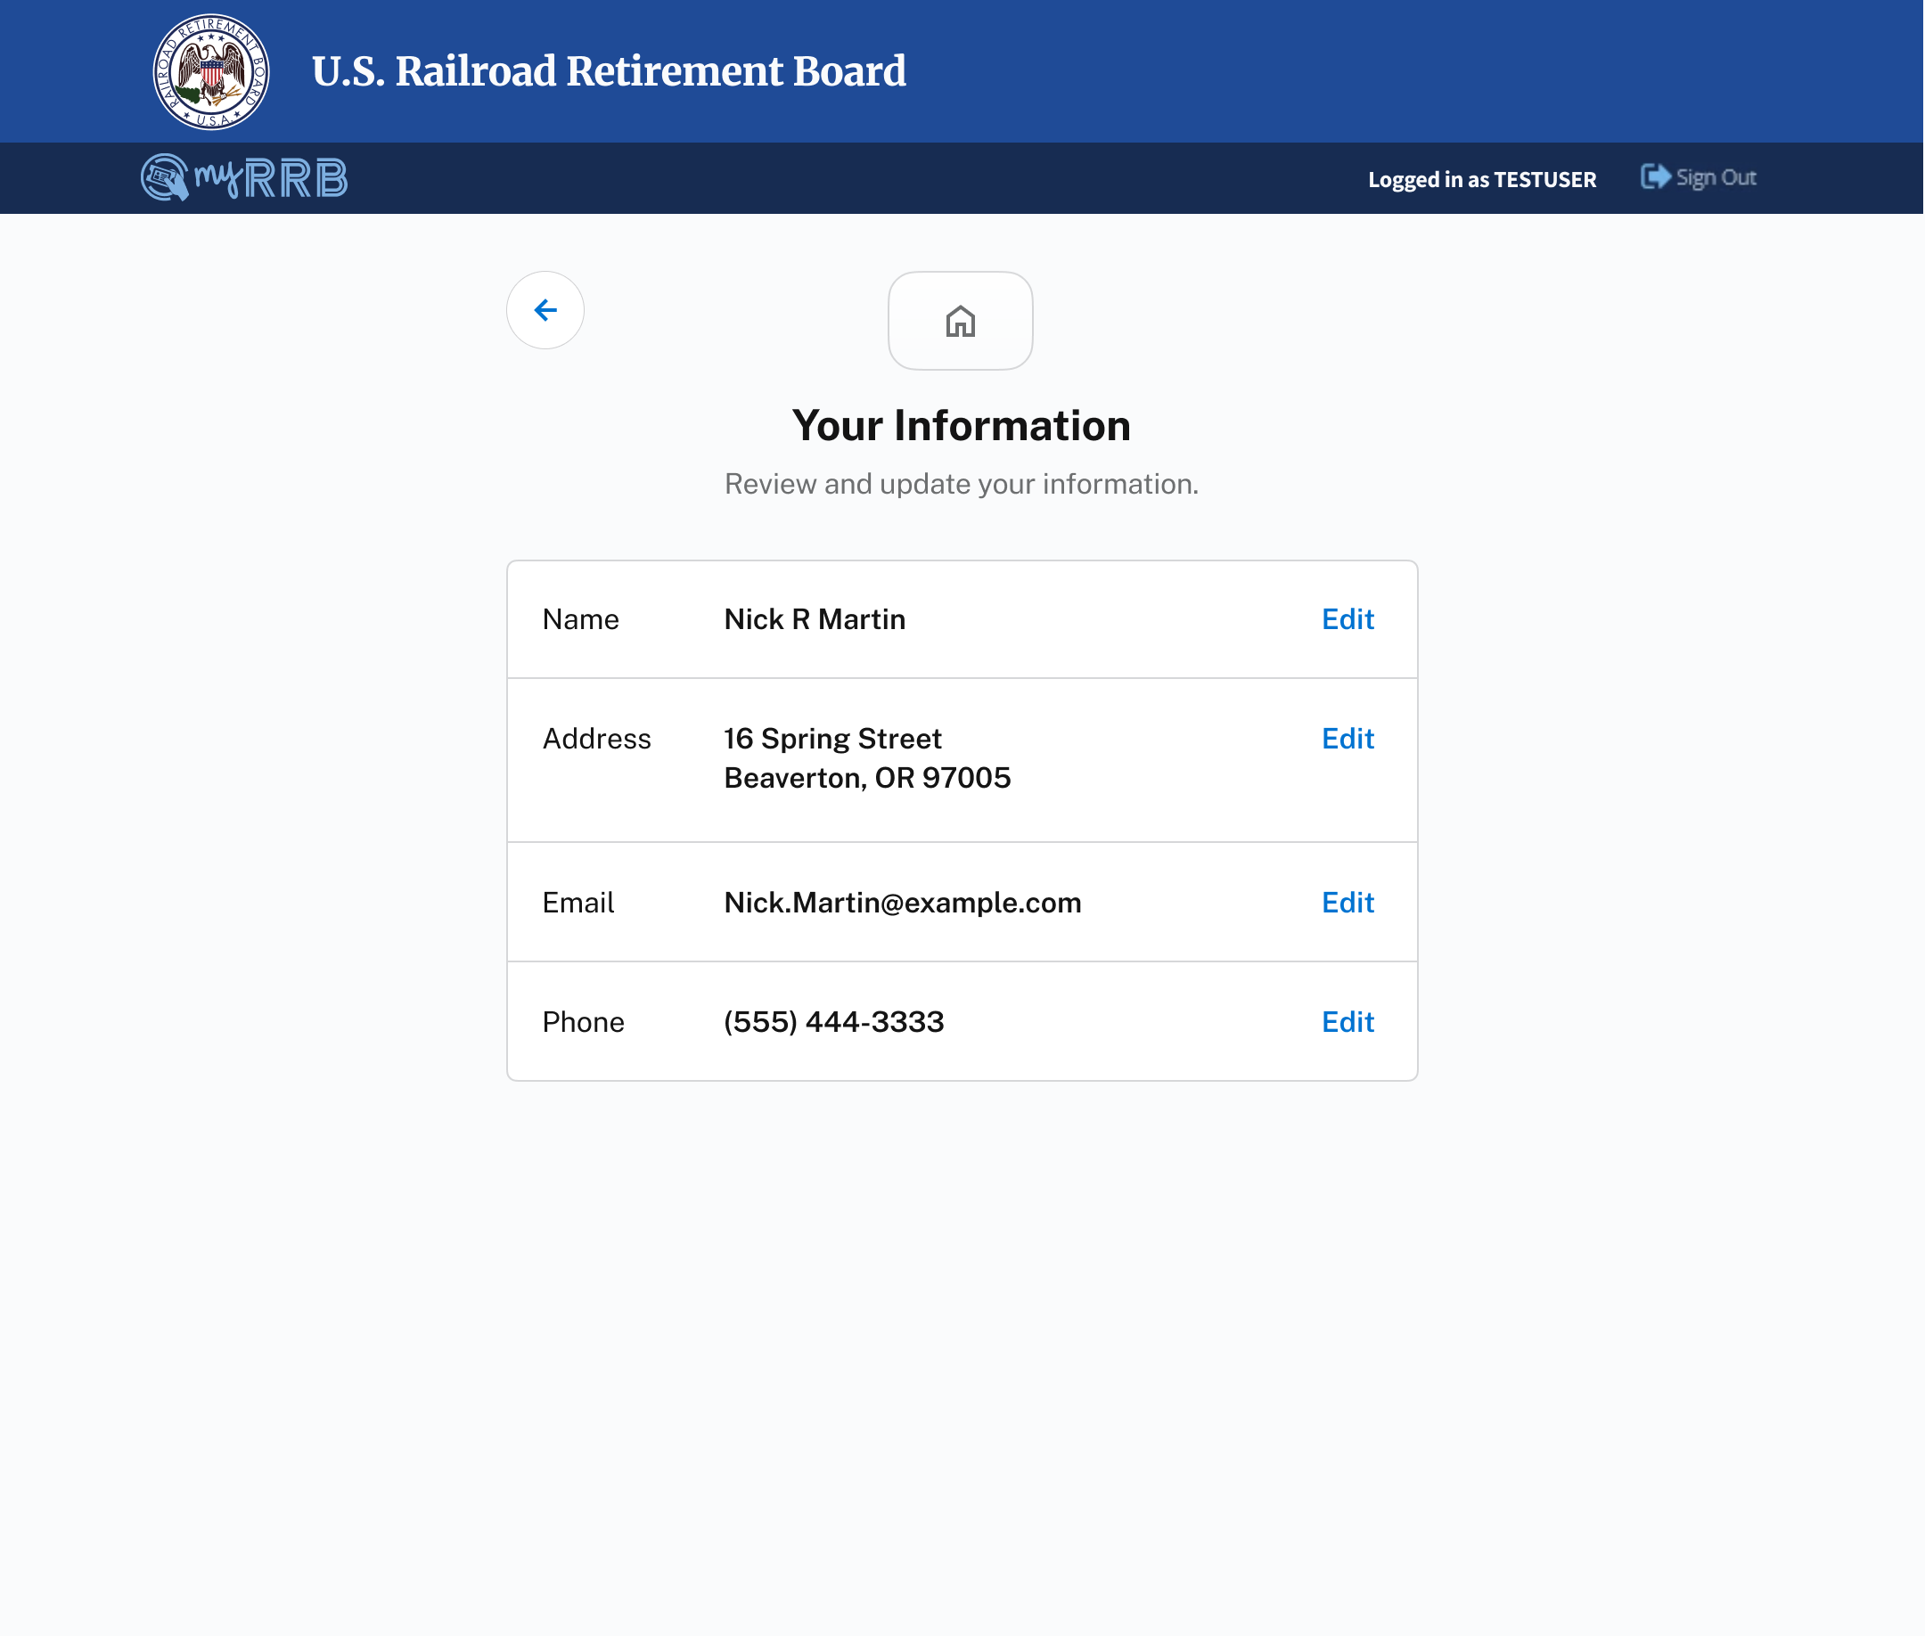
Change of Address
Your Information
Users can view and manage their profile information.
1
Users have one address associated with their myRRB profile that’s used throughout myRRB. This address can be changed by clicking on the edit button.
1
3

Slide 4
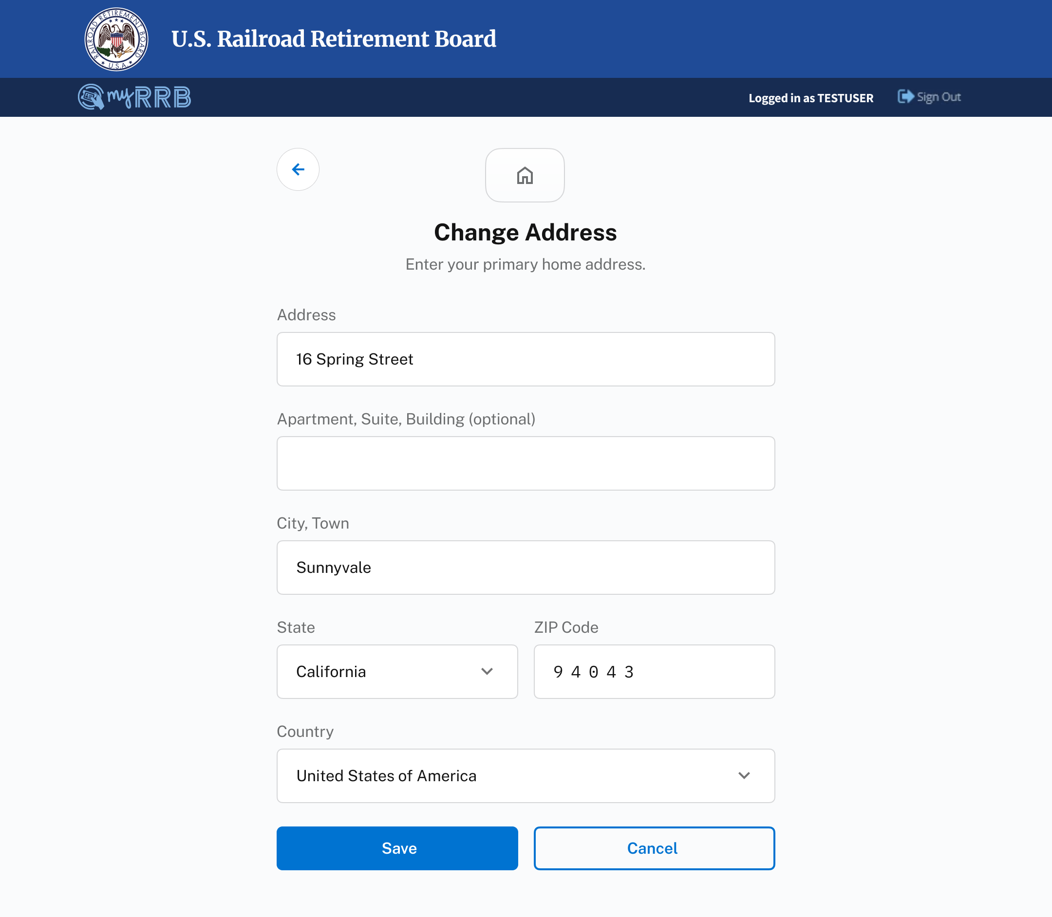
Change of Address
Edit Address
1
The user’s current myRRB profile’s address is populated in the form fields.
1
4

Slide 5
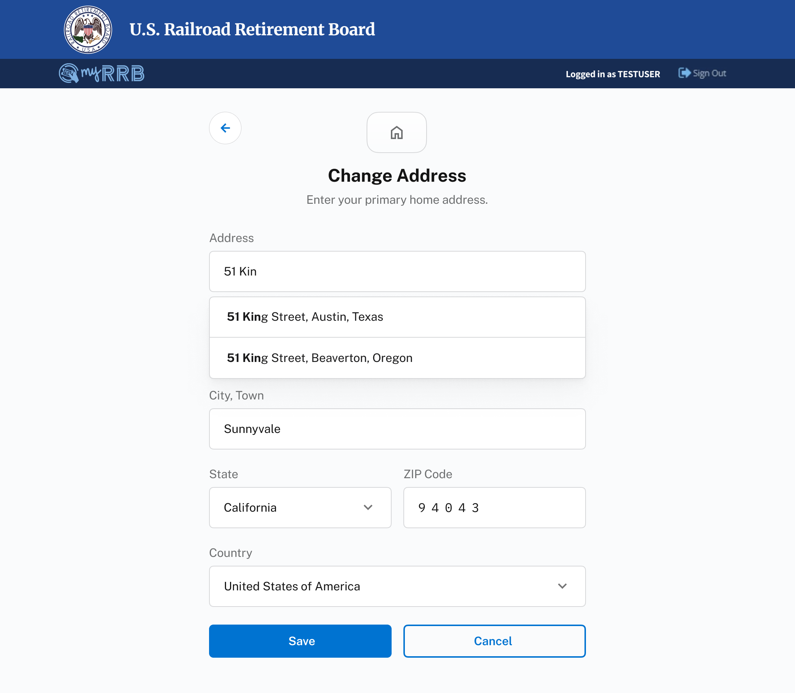

Change of Address
Edit Address
2
As a user types in their address, suggested addresses appear in a dropdown. These addresses are valid addresses.
3
Once an address is selected, other fields are automatically populated.
2
3
5

Slide 6
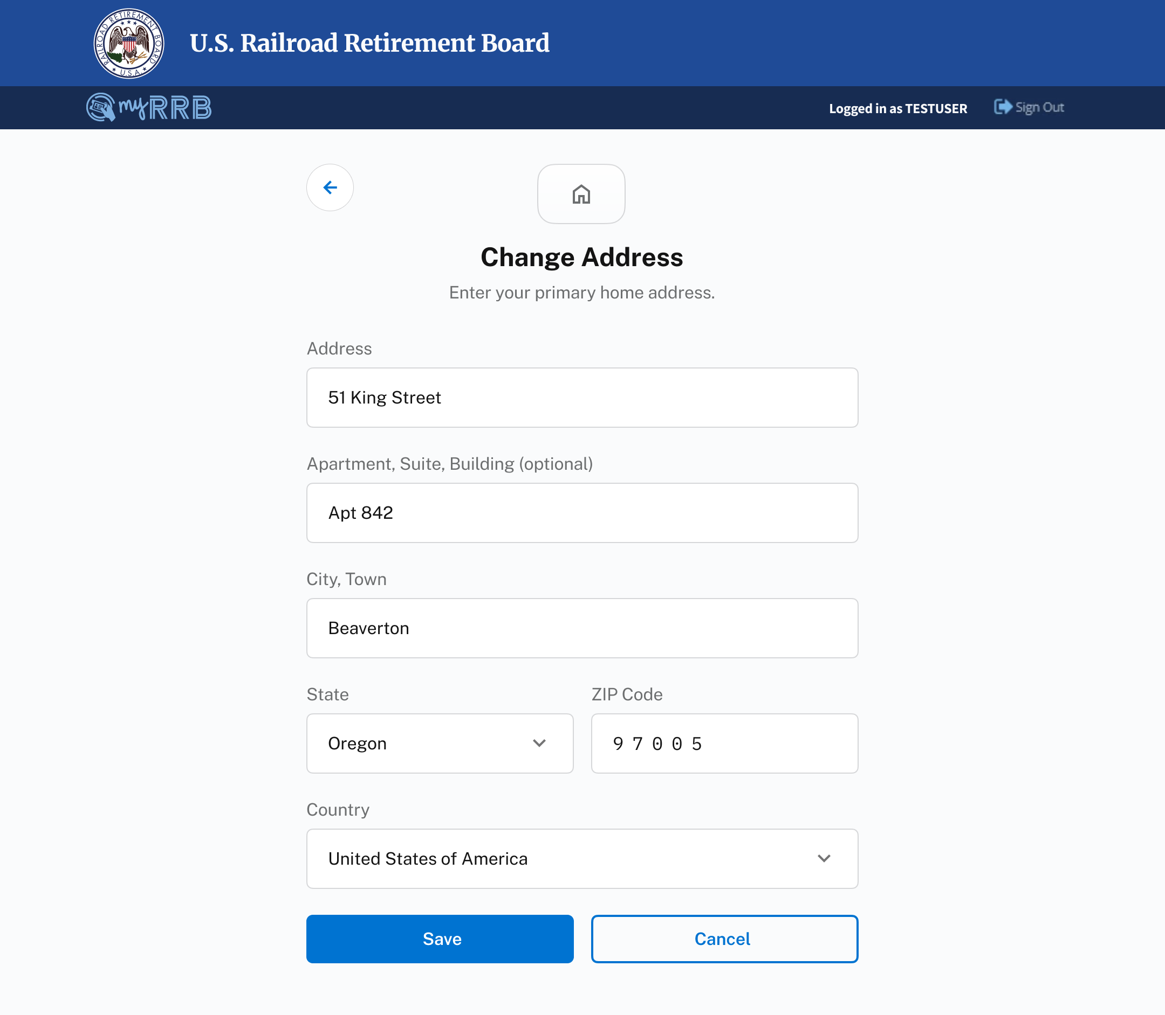
Change of Address
Edit Address
4
Users can optionally add an apartment number.
4
6

Slide 7
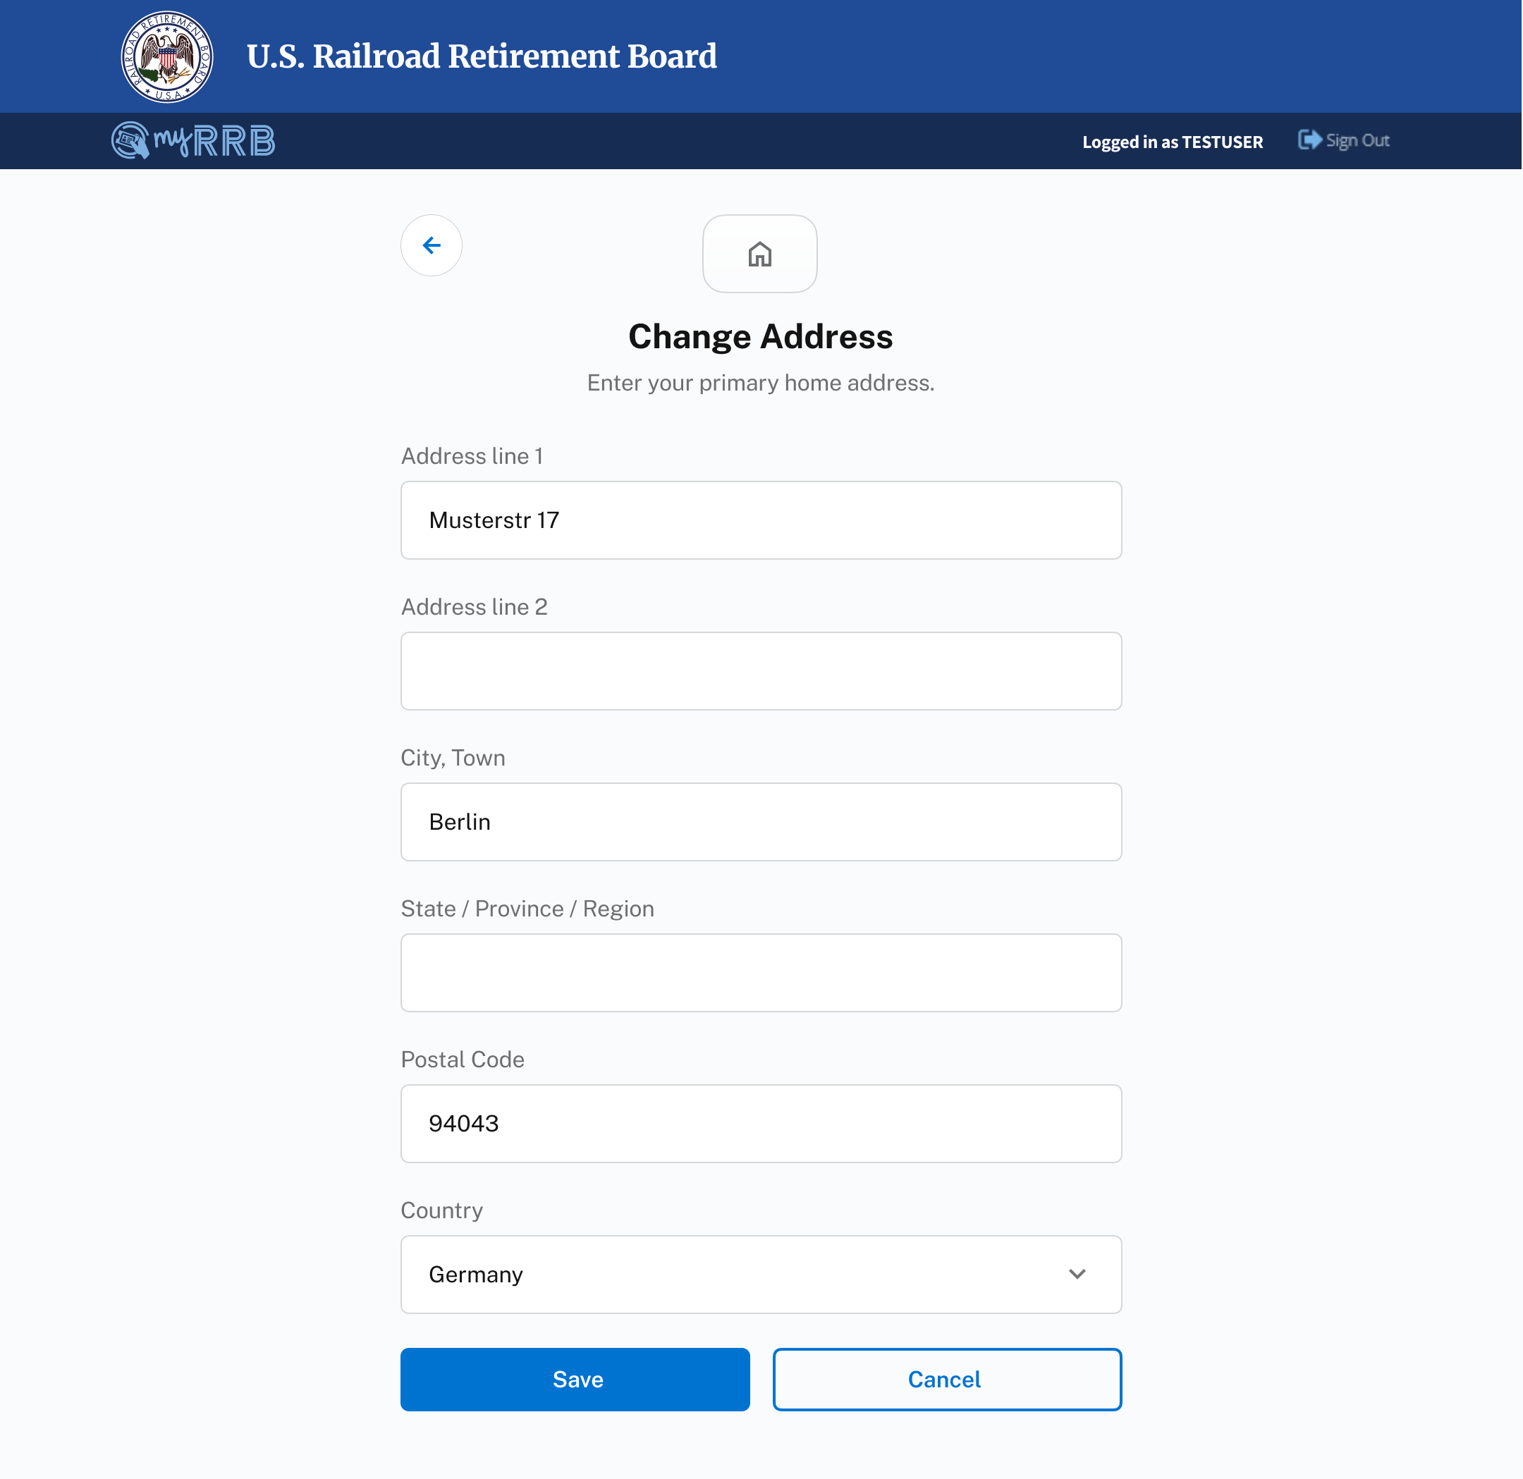
Change of Address
International Addresses
A generic address form is used for all international addresses.
1
Generic labels are used for form elements.
1
2
All form elements are full-width, helping users avoid confusion with their country’s specific address block formatting.
3
The State/Province/Region becomes a text field instead of a dropdown.
2
3
4
4
The postal code becomes a standard text field that allows letters and numbers to account for differences between countries.
5
5
When changing country, all previously input values are applied to the generic form elements if possible.
7

Slide 8
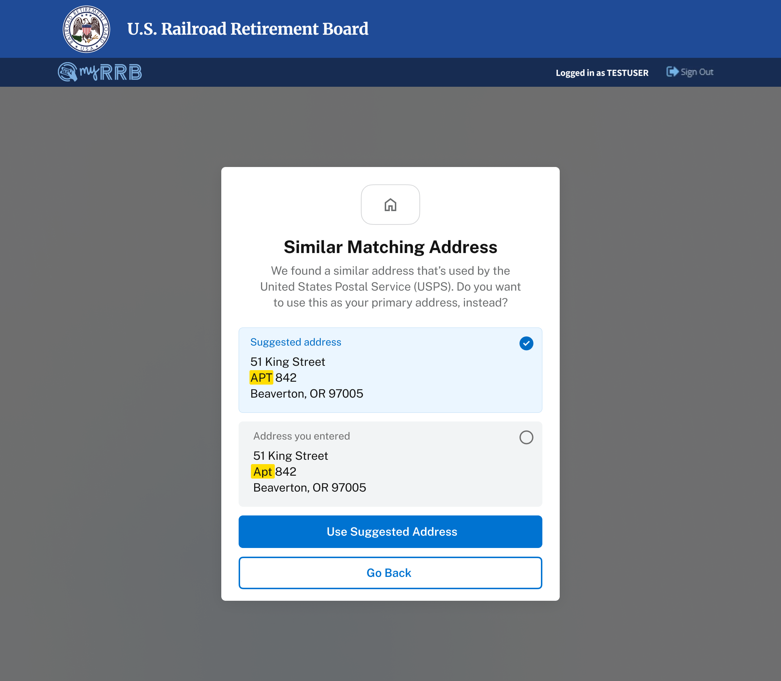
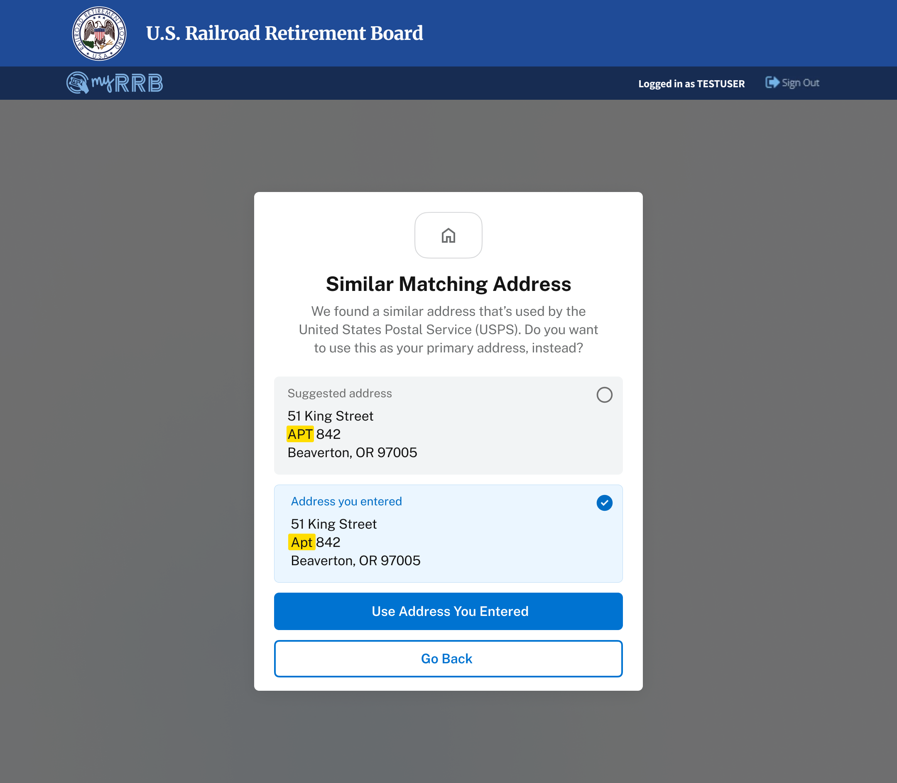
Change of Address
Validating Address
After clicking on the save button, the user’s entered address is validated.
1
If an entered address isn’t valid, but a similar matching address is found, a modal appears asking the user if they want to use this address, instead. The suggested address is selected by default and the primary CTA reads “Use Suggested Address”.
1
2
Note: if the user selects to use the address they’ve entered, instead, the primary CTA button reads “Use Address You Entered”.
2
3
Users can go back to the previous form to make further edits before saving.
3
8

Slide 9
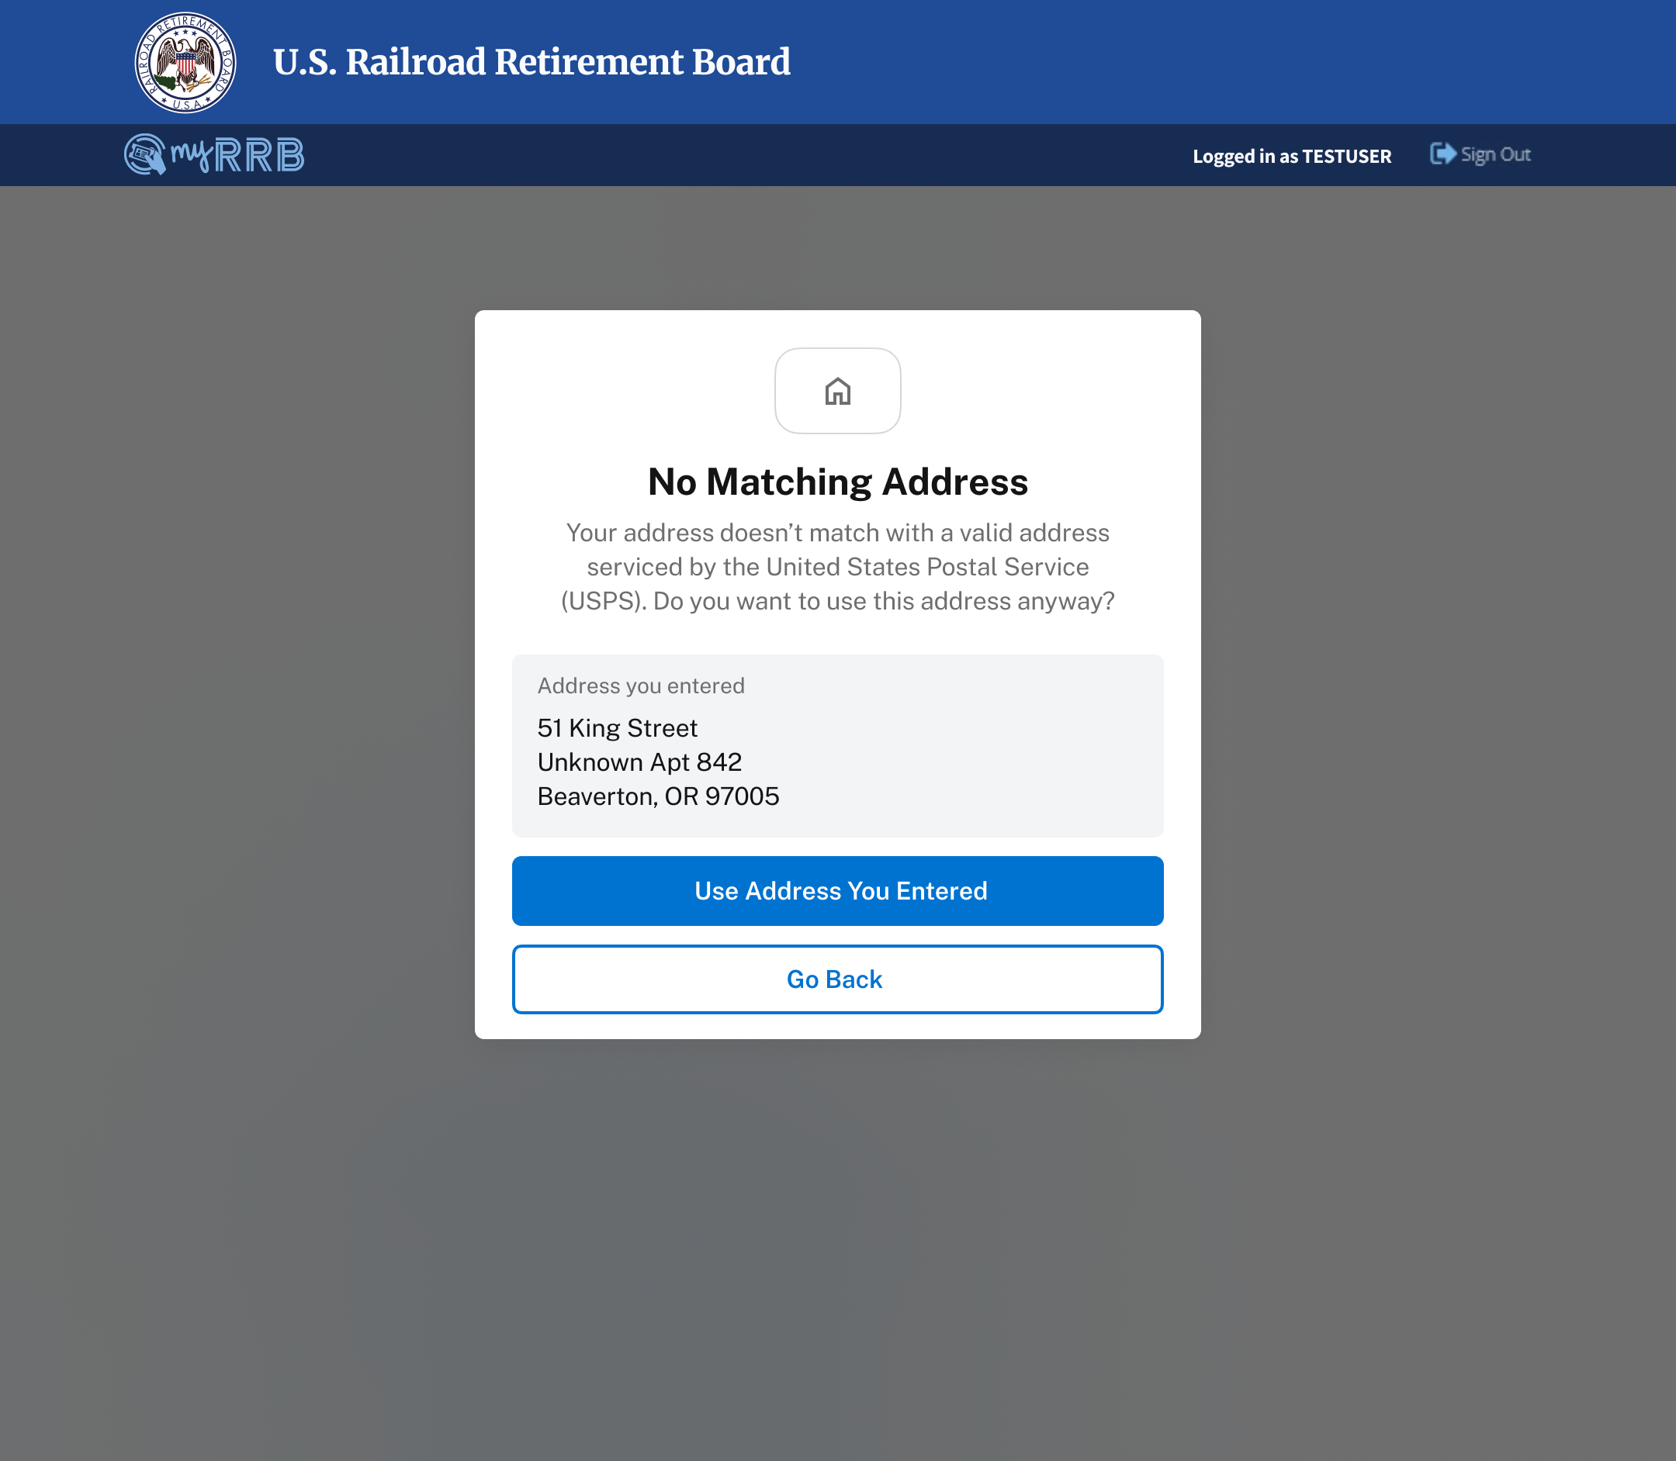
Change of Address
Validating Address
After clicking on the save button, the user’s entered address is validated.
4
If an entered address isn’t valid and there isn’t a similar matching address, a modal appears to confirm if the user wants to continue to use the address they’ve entered or if they want to go back and make further edits.
4
9

Slide 10
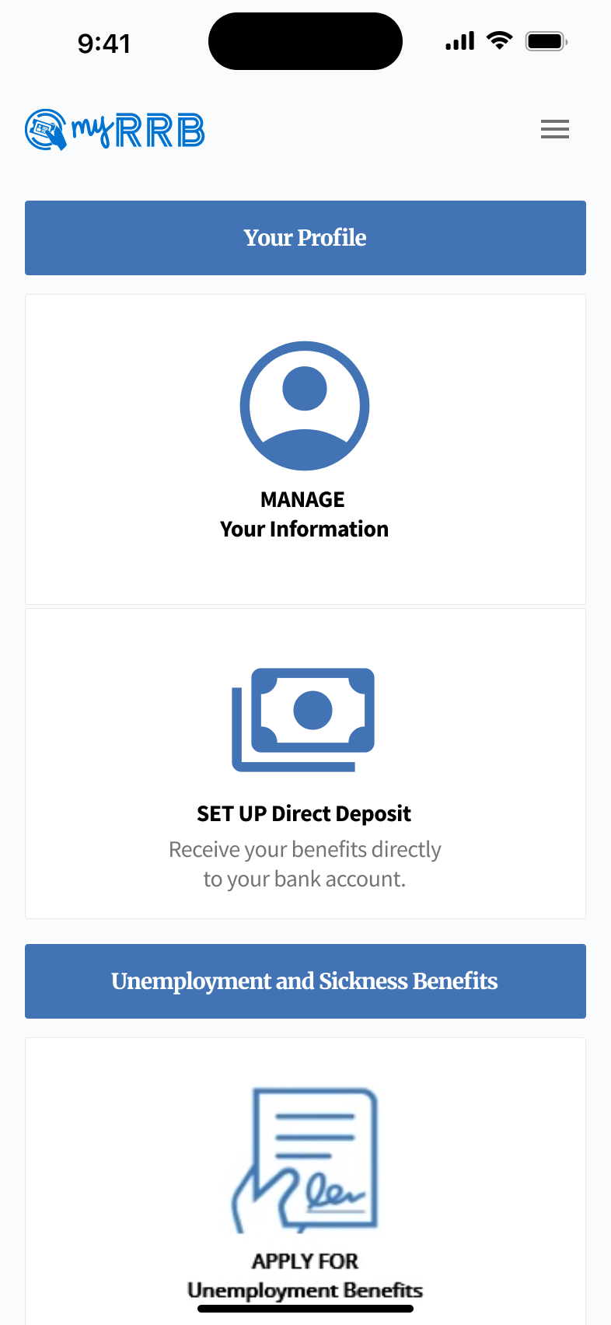
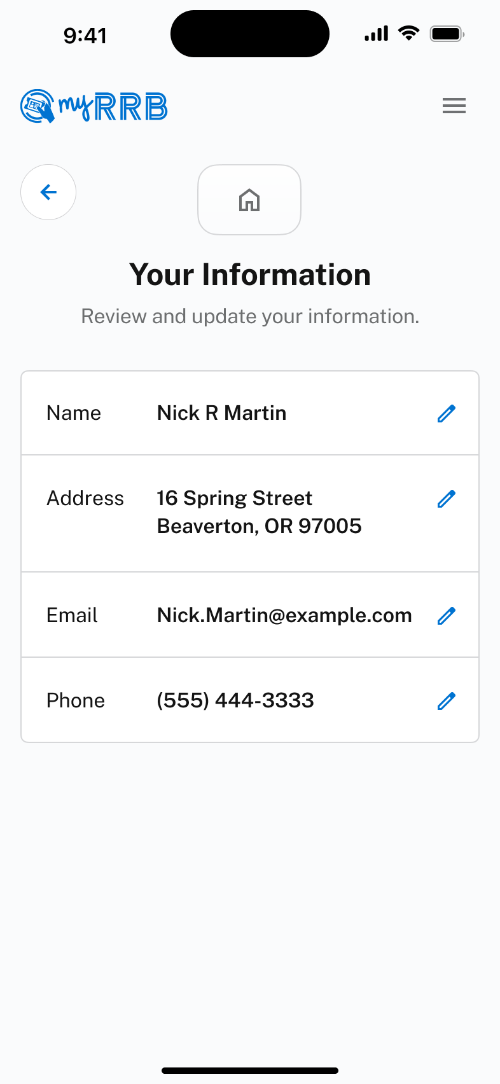
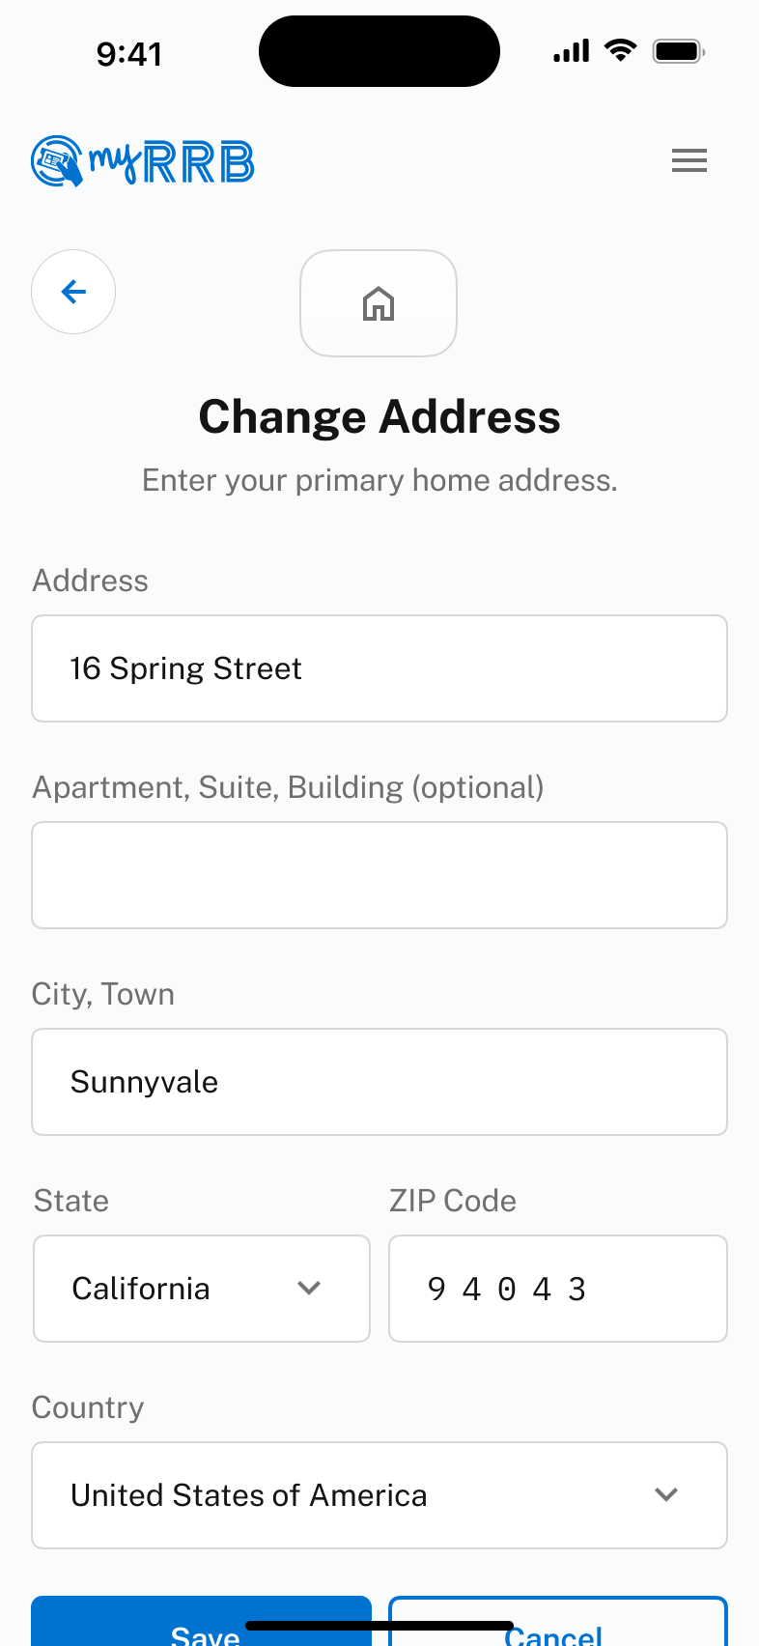
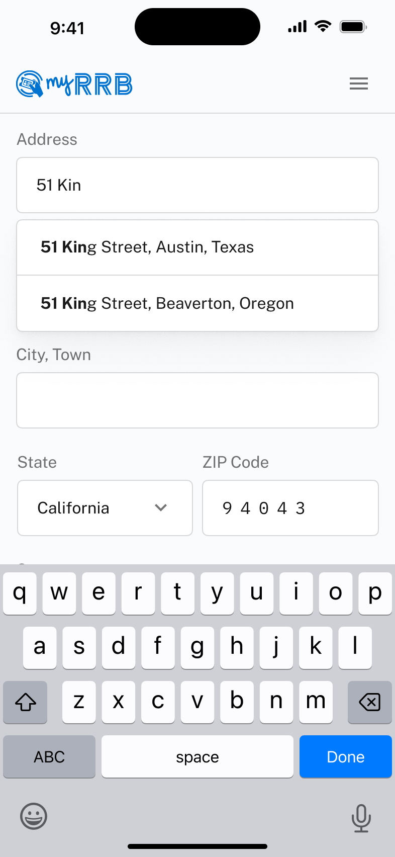
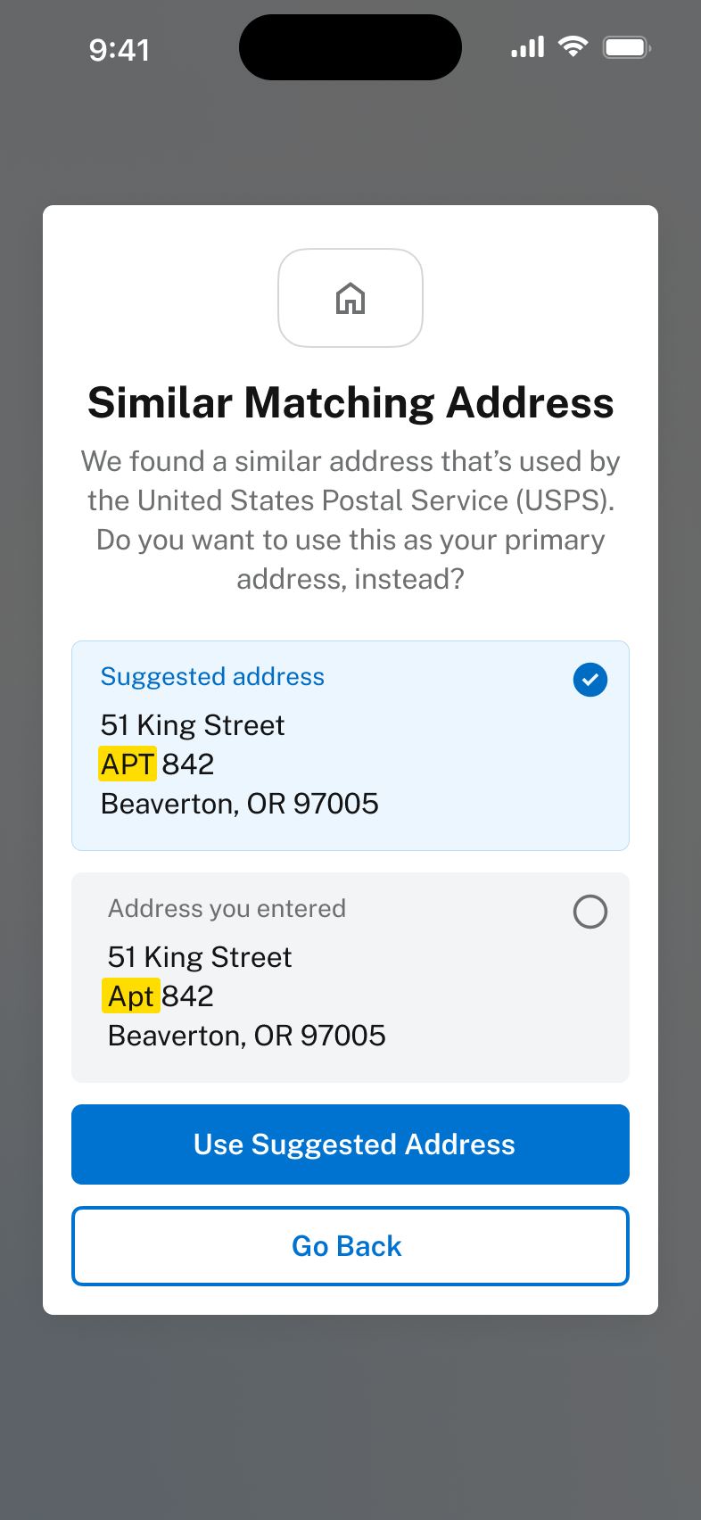
Direct Deposit
Mobile Designs
10

Slide 11


